Slide 1
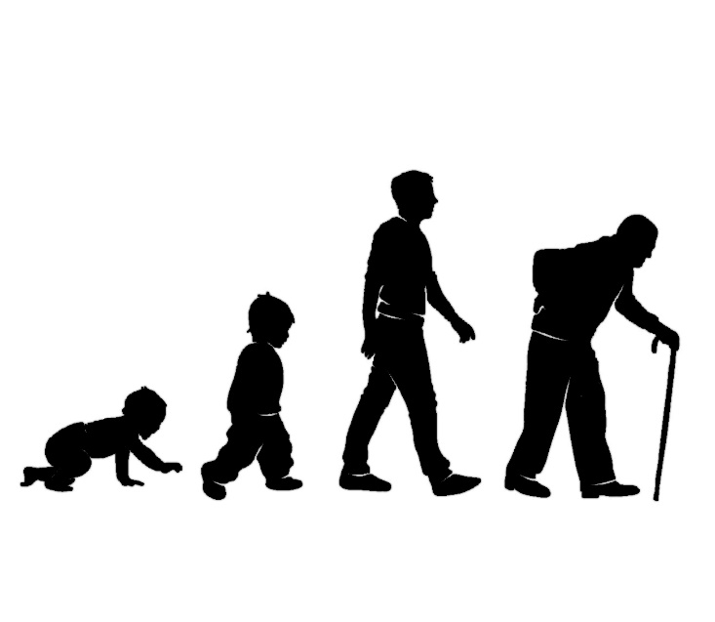
Living as children of light
in the face of
Getting older
2 Corinthians
4 v 1 -18

Slide 2
Introduction
Getting older
Chasing after Eternal youth?
Independent or Dependent?
Paul’s summary of getting older (2 Cor 4:16-18)
¹⁶ Therefore we do not lose heart. Though outwardly we are wasting away, yet inwardly we are being renewed day by day. ¹⁷ For our light and momentary troubles are achieving for us an eternal glory that far outweighs them all. ¹⁸ So we fix our eyes not on what is seen, but on what is unseen, since what is seen is temporary, but what is unseen is eternal.

Slide 3
1. Treasures in jars of clay
Getting older
Therefore…(v.1)
Therefore, since through God’s mercy we have this ministry, we do not lose heart.
This ministry…(2 Cor 2:12-16)
¹² Now when I went to Troas to preach the gospel of Christ…. ¹⁴ But thanks be to God, who…uses us to spread the aroma of the knowledge of him everywhere. ¹⁵ For we are to God the pleasing aroma of Christ among those who are being saved and those who are perishing. ¹⁶ To the one we are an aroma that brings death; to the other, an aroma that brings life.

Slide 4
1. Treasures in jars of clay
Getting older
Therefore… (v.1)
Therefore, since through God’s mercy we have this ministry, we do not lose heart.
We do not lose heart even though…(v.4-6)
⁴ The god of this age has blinded the minds of unbelievers, so that they cannot see the light of the gospel that displays the glory of Christ, who is the image of God. ⁵ For what we preach is not ourselves, but Jesus Christ as Lord, and ourselves as your servants for Jesus’ sake. ⁶ For God, who said, “Let light shine out of darkness, made his light shine in our hearts to give us the light of the knowledge of God’s glory displayed in the face of Christ.

Slide 5
1. Treasures in jars of clay
Getting older
Treasure in jars of clay…weakness to strength (v.4-7)
But we have this treasure in jars of clay to show that this all-surpassing power is from God and not from us..
Treasure in jars of clay…death to life (v.10-12)
¹⁰ We always carry around in our body the death of Jesus, so that the life of Jesus may also be revealed in our body. ¹¹ For we who are alive are always being given over to death for Jesus’ sake, so that his life may also be revealed in our mortal body. ¹² So then, death is at work in us, but life is at work in you.

Slide 6
1. Treasures in jars of clay
Getting older
Incentives (v.14-15)
Thanksgiving as more people hear, to God’s glory
Raised up in Christ and presented to God
Incentives…eternity with Christ is ahead (v.16-18)
¹⁶ Therefore we do not lose heart. Though outwardly we are wasting away, yet inwardly we are being renewed day by day. ¹⁷ For our light and momentary troubles are achieving for us an eternal glory that far outweighs them all. ¹⁸ So we fix our eyes not on what is seen, but on what is unseen, since what is seen is temporary, but what is unseen is eternal.

Slide 7
2. Made in the image of God
Getting older
Our identity (Gen 1:26-27)
²⁶ Then God said, “Let us make mankind in our image, in our likeness…” ²⁷ So God created mankind in his own image, in the image of God he created them; male and female he created them.
God’s friends
Made from dust…made dependent (Gen 2:7)
⁷ Then the Lord God formed a man from the dust of the ground and breathed into his nostrils the breath of life, and the man became a living being.

Slide 8
2. Made in the image of God
Getting older
Made for companionship (Gen 1:28)
²⁸ God blessed them and said to them, “Be fruitful and increase in number; fill the earth and subdue it. Rule over the fish in the sea and the birds in the sky and over every living creature that moves on the ground.”
Made to be social…to be dependent on God and each other
3. A dependent Jesus
Christ’s life

Slide 9
4. Interdependent people
Getting older
“I need someone with skin on”
Loneliness in a digital age
There has been a trade-off between digital connections and actually getting together with friends.
Social media tends to promote quantity of relationships over quality.
Digital communication involves social distance, and
Young people on social media may observe what their friends are doing without them, and this may increase feelings of social isolation.

Slide 10
4. Interdependent people
Getting older
Our vulnerability (v.7)
⁷ But we have this treasure in jars of clay to show that this all-surpassing power is from God and not from us.
Our renewal (Isa 40;31)
But those who hope in the Lord will renew their strength. They will soar on wings like eagles; they will run and not grow weary; they will walk and not be faint.

Slide 11
1. Treasure in jars of clay – don’t lose heart 2. Made in the image of God – made for God and each other 3. A dependent Jesus – an encouraging example 4. Interdependent people – God’s purpose for our lives
Getting older

