Slide 1
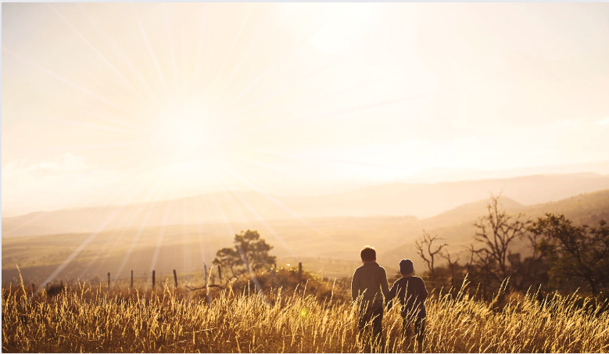
Ephesians
Walking humbly with God

Slide 2
The Walk
of the Christian
(Part 1)
Ephesians
4:1
Living worthy of our calling
These instructions (Ch4-6)…
Start with the church
1. We are one people = Unity
(4:2-16)
Christian unity depends on our conduct (vs.2)
Christian unity comes from our God (vs.3-6)
Christian unity is enriched by Christ’s gifts (vs.7-12)
Christian unity demands spiritual growth (vs.13-16)

Slide 3
The Walk
of the Christian
(Part 7)
Ephesians
4:7-12
Christian unity is enriched by Christ’s gifts (2)
Gifts for every believer (vs.7)
Gifts from the ascended Christ (vs.8-10)
Gifts in the form of people (vs.11)
Apostles
Prophets
Evangelists
Pastor-teachers
To equip & build up the church (vs.12)
‘Each of you should use whatever gift you have received to serve others, as faithful stewards of God’s grace in its various forms.’
1 Peter 4:10
‘Church is not just there to bless me, as though I am a shopper filling my basket in the supermarket. The opposite is true: we’re saved and given to our churches as gifts to bless others by serving them. We are not meant to be consumers but contributors!’ Richard Coekin

Slide 4
The Walk
of the Christian
(Part 8)
Ephesians
4:13-16
Christian unity demands spiritual growth
Objective: To be like Christ (vs.13)
‘…so that Christ may dwell in your hearts through faith. And I pray that you, being rooted and established in love, may have power, together with all the Lord’s holy people, to grasp how wide and long and high and deep is the love of Christ, and to know this love that surpasses knowledge - that you may be filled to the measure of all the fullness of God.’ Ephesians 3:17-19

Slide 5
The Walk
of the Christian
(Part 8)
Ephesians
4:13-16
Christian unity demands spiritual growth
Objective: To be like Christ (vs.13)
‘…so that Christ may dwell in your hearts through faith. And I pray that you, being rooted and established in love, may have power, together with all the Lord’s holy people, to grasp how wide and long and high and deep is the love of Christ, and to know this love that surpasses knowledge - that you may be filled to the measure of all the fullness of God.’ Ephesians 3:17-19

Slide 6
The Walk
of the Christian
(Part 8)
Ephesians
4:13-16
Christian unity demands spiritual growth
Objective: To be like Christ (vs.13)
‘Being confident of this, that He who began a good work in you will carry it on to completion until the day of Christ Jesus.’
Philippians 1:6

Slide 7
The Walk
of the Christian
(Part 8)
Ephesians
4:13-16
Christian unity demands spiritual growth
Objective: To be like Christ (vs.13)
We don’t want to be infants (vs.14)
We do want to grow & mature (vs.13,15-16)
‘I gave you milk not solid food, for you were not yet ready for it. Indeed, you are still not ready.’
1 Corinthians 3:2

Slide 8
The Walk
of the Christian
(Part 8)
Ephesians
4:13-16
Christian unity demands spiritual growth
Objective: To be like Christ (vs.13)
We don’t want to be infants (vs.14)
We do want to grow & mature (vs.13,15-16)
By speaking the truth in love
‘Sanctify them by the truth; your Word is truth.’
John 17:17
‘For He chose us in Him before the creation of the world to be holy and blameless in His sight.’
Ephesians 1:4

Slide 9
The Walk
of the Christian
(Part 8)
Ephesians
4:13-16
Christian unity demands spiritual growth
Objective: To be like Christ (vs.13)
We don’t want to be infants (vs.14)
We do want to grow & mature (vs.13,15-16)
By speaking the truth in love
‘The truth becomes hard if it is spoken without love and love becomes soft if it is lacking truth.’
Alistair Begg

Slide 10
The Walk
of the Christian
(Part 8)
Ephesians
4:13-16
Christian unity demands spiritual growth
Objective: To be like Christ (vs.13)
We don’t want to be infants (vs.14)
We do want to grow & mature (vs.13,15-16)
By speaking the truth in love
By always looking to Christ
‘From Him…’ (vs.16)
‘Do you not know that in a race all the runners run, but only one gets the prize? Run in such a way as to get the prize.’ 1 Corinthians 9:24

Slide 11
The Walk
of the Christian
(Part 8)
Ephesians
4:13-16
Christian unity demands spiritual growth
Objective: To be like Christ (vs.13)
We don’t want to be infants (vs.14)
We do want to grow & mature (vs.13,15-16)
By speaking the truth in love
By always looking to Christ
‘From Him…’ (vs.16)
‘…let us run with perseverance the race marked out for us, fixing our eyes on Jesus, the pioneer and perfecter of faith.’ Hebrews 12:1-2

Slide 12
The Walk
of the Christian
(Part 8)
Ephesians
4:13-16
Christian unity demands spiritual growth
Objective: To be like Christ (vs.13)
We don’t want to be infants (vs.14)
We do want to grow & mature (vs.13,15-16)
By speaking the truth in love
By always looking to Christ
By each part doing its work
‘For we are God’s handiwork created in Christ Jesus to do good works, which God prepared in advance for us to do.’ Ephesians 2:10

Slide 13
Ephesians
Walking humbly with God

