Slide 2
John 5:16-30
‘Like Father, Like Son’

Slide 3
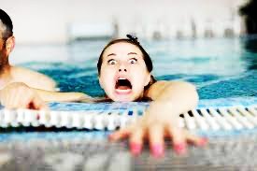
‘Like Father, Like Son’ - John 5:16-30

Slide 4
‘Like Father, Like Son’ - John 5:16-30
So, because Jesus was doing these things on the Sabbath, the Jewish leaders began to persecute him. In his defense Jesus said to them, “My Father is always at his work to this very day, and I too am working.” For this reason they tried all the more to kill him; not only was he breaking the Sabbath,

Slide 5
‘Like Father, Like Son’ - John 5:16-30
but he was even calling God his own Father, making himself equal with God.
John 5: 16-18

Slide 6
‘Like Father, Like Son’ - John 5:16-30
Shocking Diversion

Slide 7
‘Like Father, Like Son’ - John 5:16-30
Then Jesus said to him, “Get up! Pick up your mat and walk.” At once the man was cured; he picked up his mat and walked.
John 5: 8-9

Slide 8
‘Like Father, Like Son’ - John 5:16-30
So, because Jesus was doing these things on the Sabbath, the Jewish leaders began to persecute him.
John 5: 16

Slide 9
‘Like Father, Like Son’ - John 5:16-30
Shocking Diversion
Challenging Depths

Slide 10
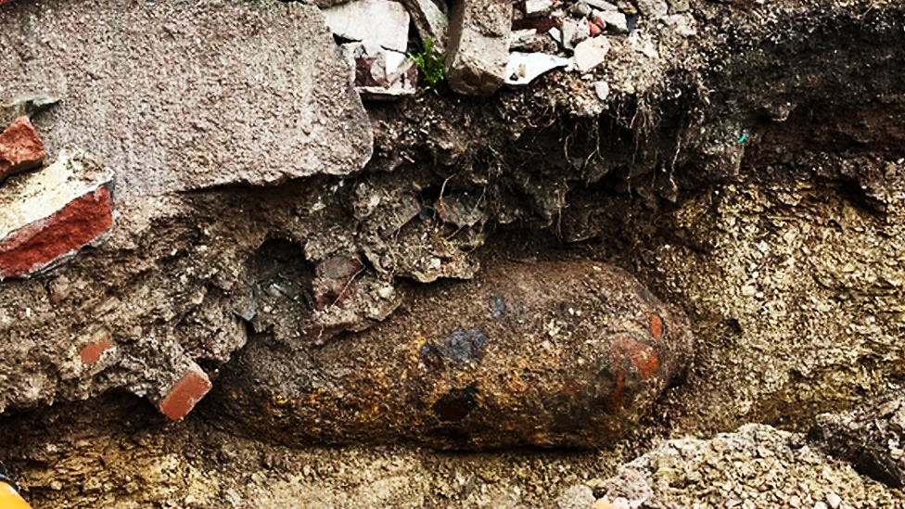
‘Like Father, Like Son’ - John 5:16-30

Slide 11
‘Like Father, Like Son’ - John 5:16-30
In his defense Jesus said to them, “My Father is always at his work to this very day, and I too am working.” For this reason, they tried all the more to kill him;

Slide 12
‘Like Father, Like Son’ - John 5:16-30
not only was he breaking the Sabbath, but he was even calling God his own Father, making himself equal with God.
John 5: 17-18

Slide 13
‘Like Father, Like Son’ - John 5:16-30
Jesus gave them this answer: “Very truly I tell you, the Son can do nothing by himself; he can do only what he sees his Father doing, because whatever the Father does the Son also does.
John 5: 19

Slide 14
‘Like Father, Like Son’ - John 5:16-30
In his defence Jesus said to them, “My Father is always at his work to this very day, and I too am working.”
John 5: 17

Slide 15
‘Like Father, Like Son’ - John 5:16-30
For the Father loves the Son and shows him all he does. Yes, and he will show him even greater works than these, so that you will be amazed.
John 5: 20

Slide 16
‘Like Father, Like Son’ - John 5:16-30
Moreover, the Father judges no one, but has entrusted all judgment to the Son,
And he has given him authority to judge because he is the Son of Man.
By myself I can do nothing; I judge only as I hear, and my judgment is just, for I seek not to please myself but him who sent me. John 5: 22,27,30

Slide 17
‘Like Father, Like Son’ - John 5:16-30
For the Father loves the Son and shows him all he does. Yes, and he will show him even greater works than these, so that you will be amazed.
John 5: 20

Slide 18
‘Like Father, Like Son’ - John 5:16-30
For just as the Father raises the dead and gives them life, even so the Son gives life to whom he is pleased to give it.
John 5: 21

Slide 19
‘Like Father, Like Son’ - John 5:16-30
“Very truly I tell you, whoever hears my word and believes him who sent me has eternal life and will not be judged but has crossed over from death to life.
John 5: 24

Slide 20
‘Like Father, Like Son’ - John 5:16-30
Very truly I tell you, a time is coming and has now come when the dead will hear the voice of the Son of God and those who hear will live.
John 5: 25

Slide 21
‘Like Father, Like Son’ - John 5:16-30
that all may honour the Son just as they honour the Father. Whoever does not honour the Son does not honour the Father, who sent him.
John 5: 23

Slide 22
‘Like Father, Like Son’ - John 5:16-30
Shocking Diversion
Challenging Depths
Awesome Destiny

Slide 23
‘Like Father, Like Son’ - John 5:16-30
“Do not be amazed at this, for a time is coming when all who are in their graves will hear his voice and come out - those who have done what is good will rise to live, and those who have done what is evil will rise to be condemned.
John 5: 28-29

Slide 24
‘Like Father, Like Son’ - John 5:16-30
that all may honour the Son just as they honour the Father. Whoever does not honour the Son does not honour the Father, who sent him.
John 5: 23

